Slide 1


Unit 1A: Be
English (Elementary, A1)
Oliver Castellanos Master in TEFL

Slide 2
Introduction ☺️
Teacher’s profile.
Class agreements.
Virtual sessions: Tuesdays and Thursdays at 7:00 AM.
Platform: individual evaluation over 5.0
Exam: ending each module (6 weeks).

Slide 3

Agenda 🗓️
Explore
Apply Reflect

Slide 4

Learning objectives 📚
The student will be able to review the forms and functions of BE. The student will be able to know new vocabulary about Technology.

Slide 5

Welcome to the class! 👨‍🏫
Conversation 1 | Conversation 2 | Conversation 3
Teacher: Hello! Everybody, Welcome to the class. I ___ Oliver! Your English teacher. Student: Hi! Thanks teacher, I ___ Paul. | Paul: Hi! I ___ Paul. What ___ your name? Ana: Hello, I ___ Ana. Paul: Nice to meet you, Ana. Ana: Nice to meet you too! | Sally: Hi! Andy Andy: Sally! ___ you in English class too? Sally: Yes, I ___. Andy: Great! You ___ my partner. Sally: Yes! See you later, Andy. Andy: Goodbye.
am
is
am
Are
am
am
am
are

Slide 6
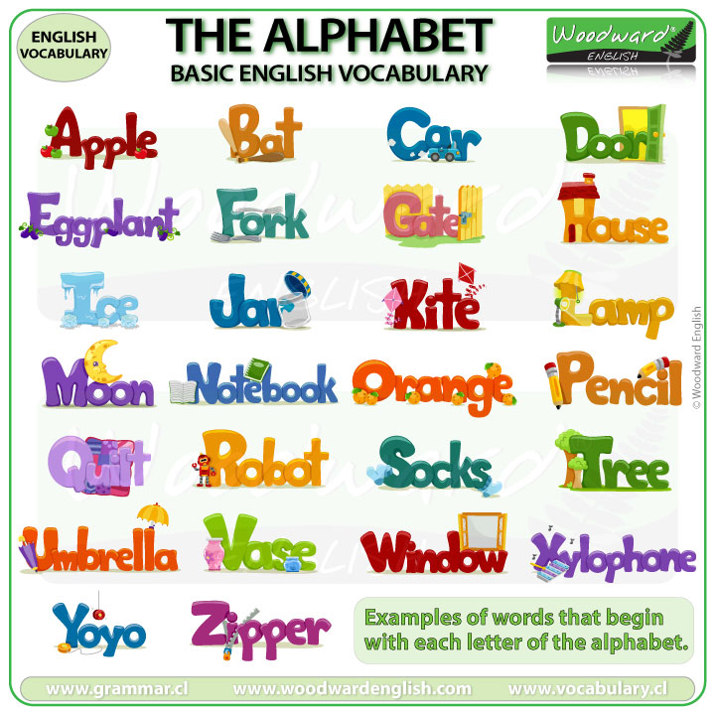
The alphabet 🔤

Slide 7
Spelling exercise 🗣️
What day ___ today? It __ M_ND_Y.
What day ___ tomorrow? It __ _UE_D_Y.
What ___ the weekdays? Those ___ _O_DA_, T_E_DA_, W_DN_S_A_, _HU_SD_Y, and F_ID_Y.
What ___ the days of the weekend? Those ___ S_T_RD_Y, and S_ND_Y.
What day ___ after tomorrow? It ___ W_D_ES_A_.
Kahoot!
is
is
O
A
A
is
is
T
S
U
S
E
D
are
are
M
N
Y
Y
E
Y
T
R
A
R
A
are
are
A
U
A
U
A
is
is
E
N
D
Y

Slide 8
Vocabulary: Technology I 💻
Computer
Email
Laptop
Touchscreen
Wi-fi
Kahoot!

Slide 9
Tongue twister 😜
The blue bluebird blinks

Slide 10
Tips! 👍
Vocabulary
Vocabulary
https://www.eslgamesplus.com/days-of-the-week-esl-vocabulary-game/
https://play.google.com/store/apps/details?id=com.britishcouncil.phonemicchart

